Slide 1
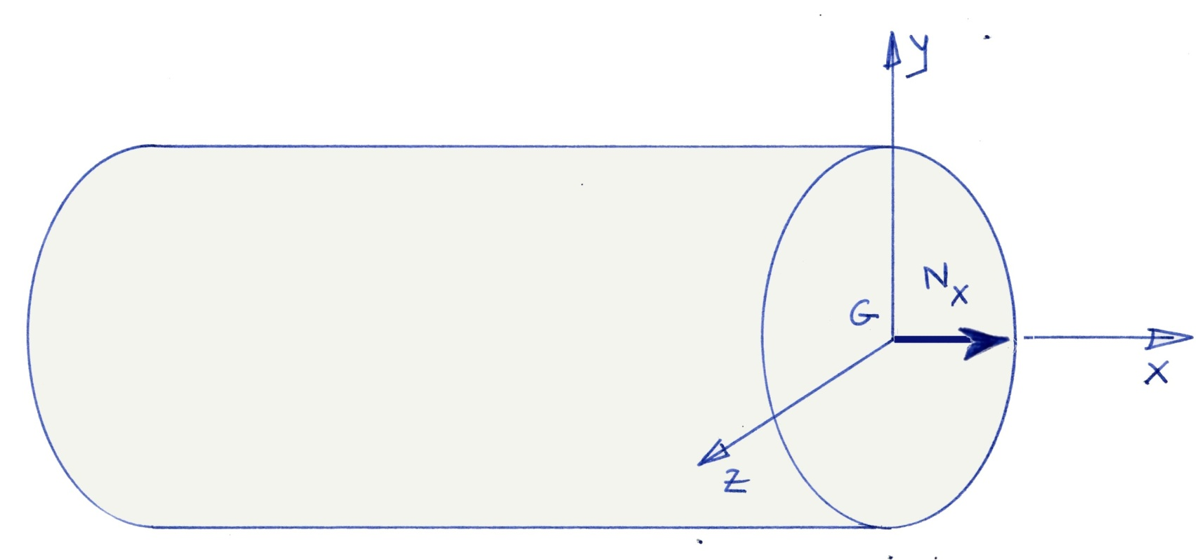
Normal Force
Normal Force - CAUC- 2011

Slide 2
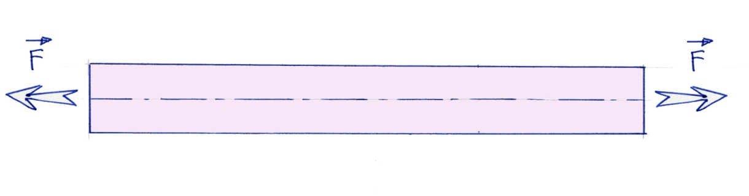
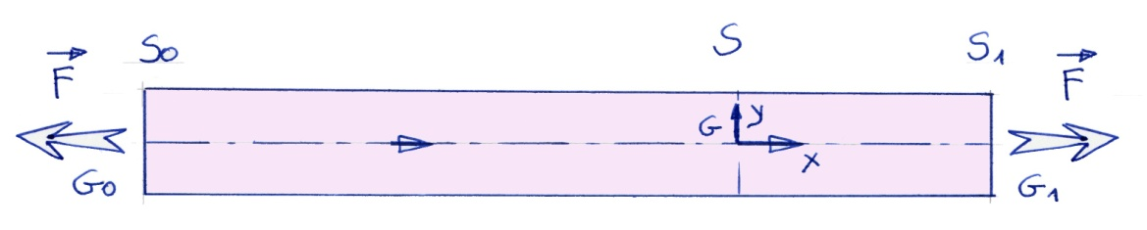
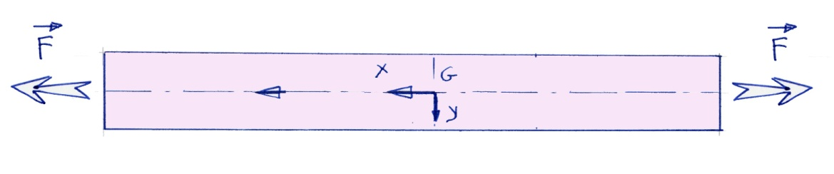
Normal Force : Exemple 1
A specimen test submetted to a tensile stress
Normal Force - CAUC- 2011

Slide 3
Normal Force : Exemple 1
Remarks :
The normal force does not depend of the orientation chosen for the middle line of the beam
When the Nx > 0 the beam is in traction
When the Nx < 0 the beam is in compression
Normal Force - CAUC- 2011

Slide 4

Normal Force : Exemple 2
Normal Force - CAUC- 2011

Slide 5
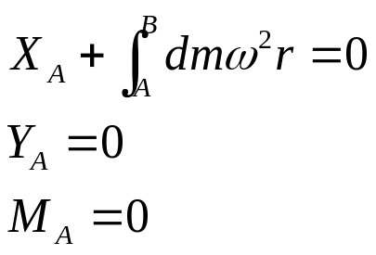
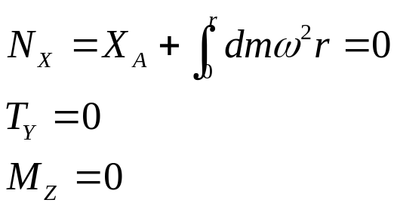
Normal Force : Exemple 2
Reactions
ILOCS
Normal Force - CAUC- 2011

Slide 6
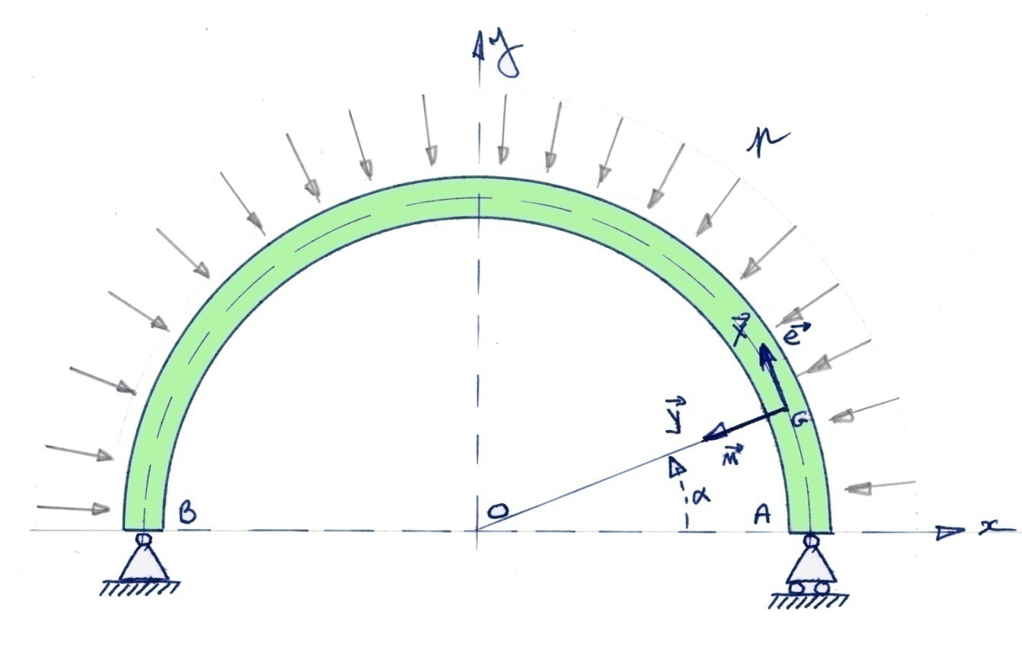
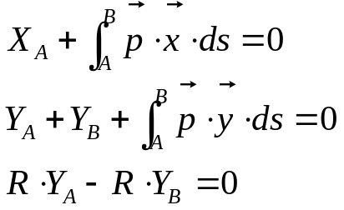
Normal Force : Exemple 3
Normal Force - CAUC- 2011

Slide 7
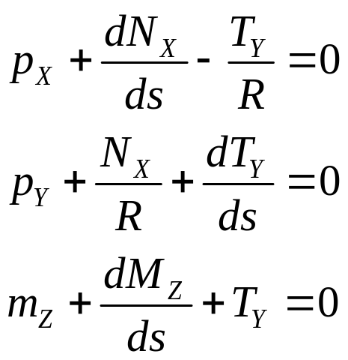
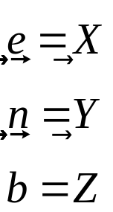
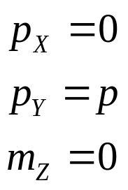
Exemple 3 : Equation of equilibrium
Middle curve in a plane,
Load in the plane of the curve
Normal Force - CAUC- 2011

Slide 8
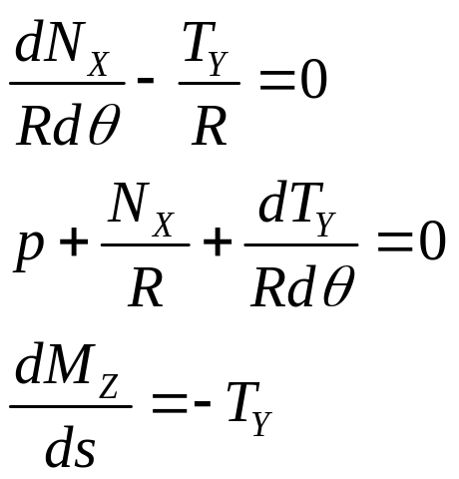
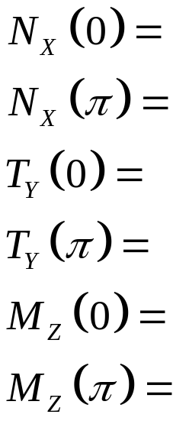
Exemple 3 : Equation of equilibrium
Equilibrium equation
Boundary conditions
Conclusion :
Normal Force - CAUC- 2011

Slide 9
Elastic Solution : Description
Constant section S
Straight line for the middle curve,
S0 and S1 the intial and final cross section
G0 Center of gravity of S0
G1 Center of gravity and S1
Normal Force - CAUC- 2011

Slide 10
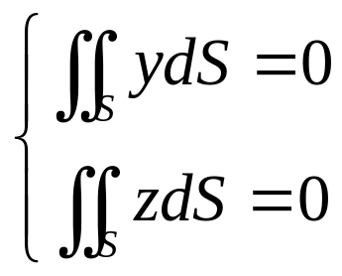
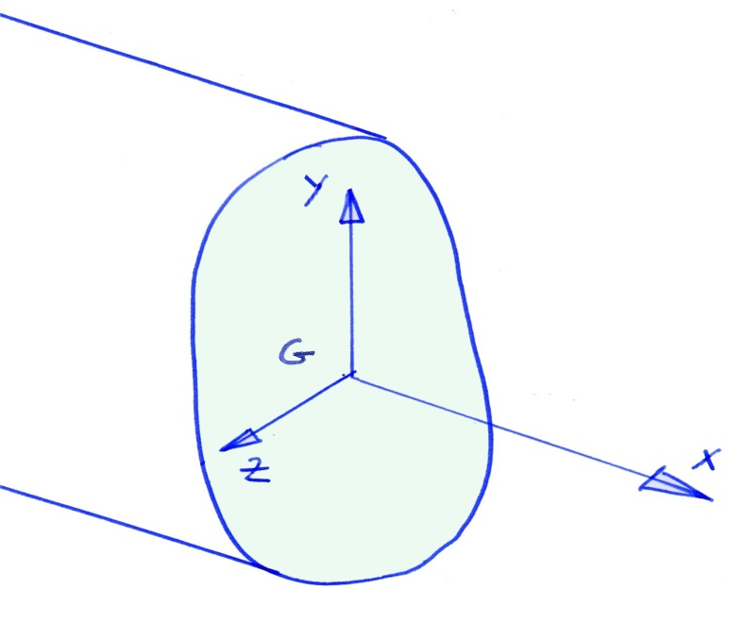
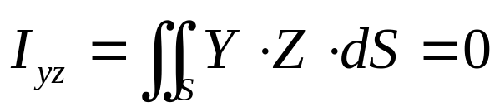
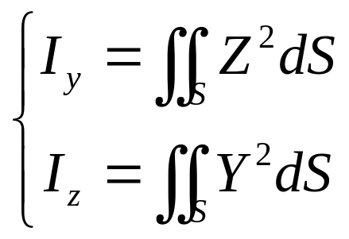
Cross Section :
Origin of the axis / Principal Axis
Normal Force - CAUC- 2011

Slide 11
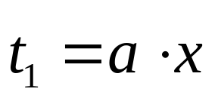
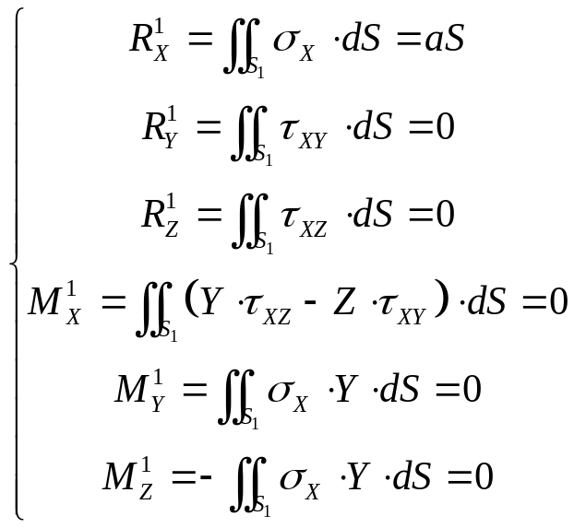
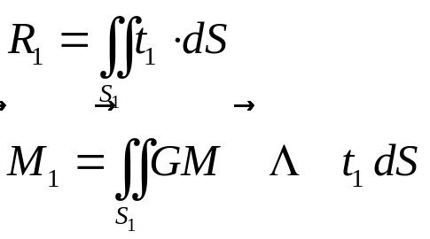
Elastic solution : Load Applied
Distributed load on the surface S1
Normal Force - CAUC- 2011

Slide 12
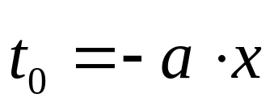
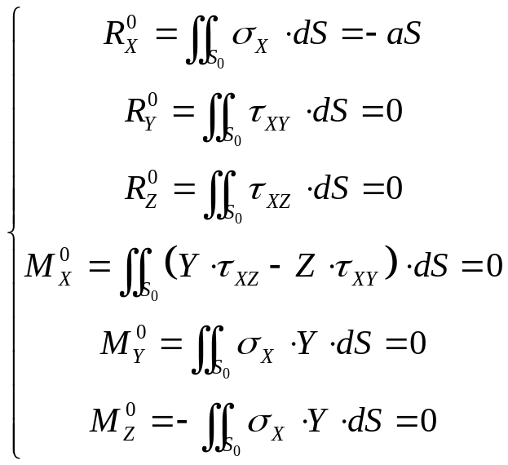
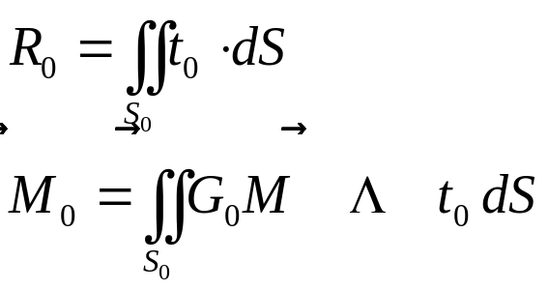
Elastic solution : Load Applied
Distributed load on the surface S0
Normal Force - CAUC- 2011

Slide 13
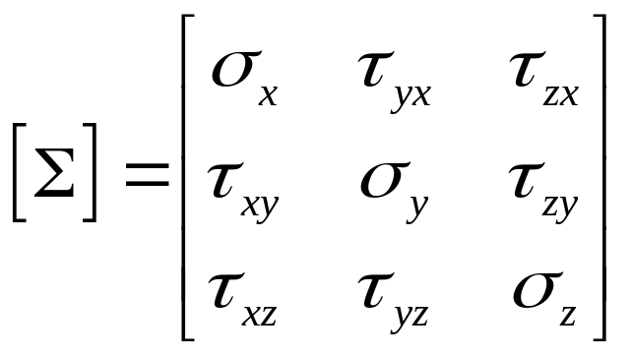
Resolution with Beltrami’s method
Find a stress tensor that verify :
The boundary conditions,
The equilibium equations
The compatibility equations,
The Hook’s relationship
Normal Force - CAUC- 2011

Slide 14
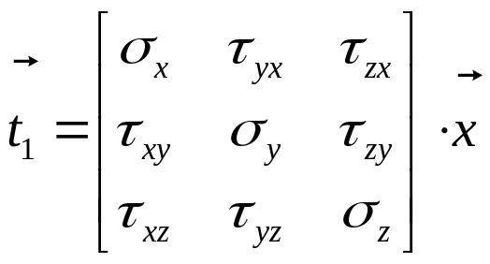
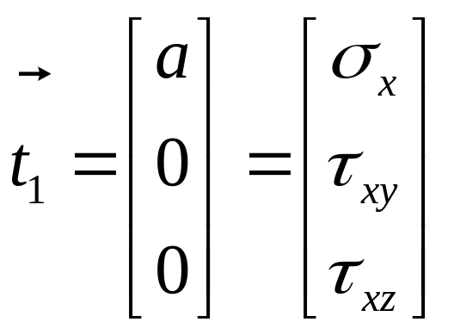
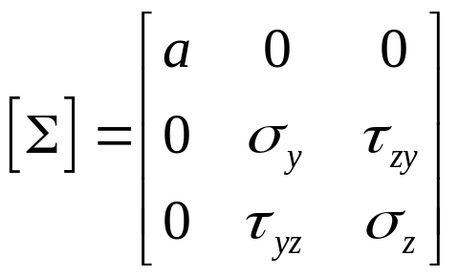
Boundary Conditions on S1
Normal Force - CAUC- 2011

Slide 15
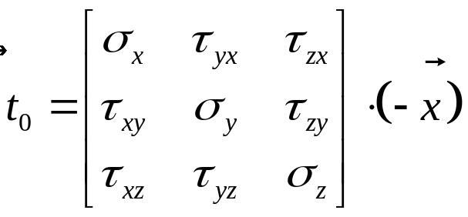
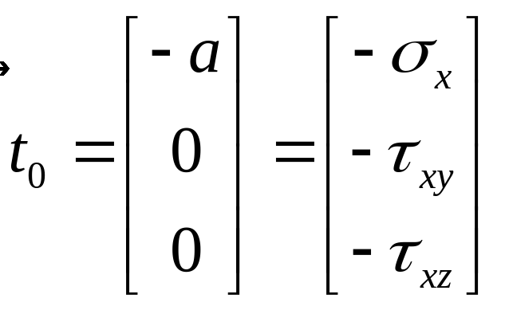
Boundary Conditions on S0
Normal Force - CAUC- 2011

Slide 16
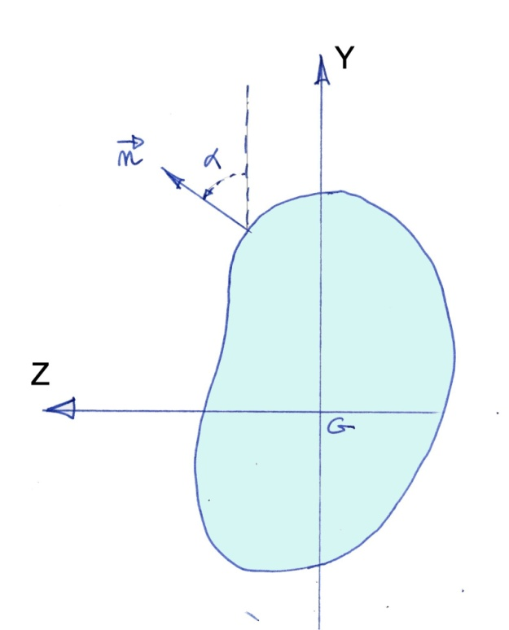
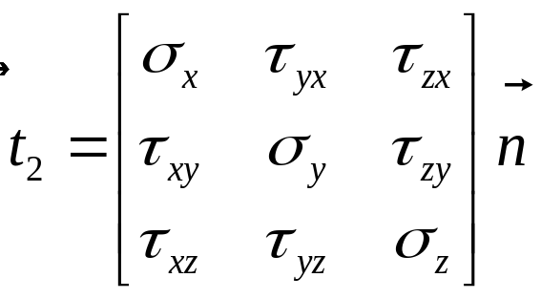
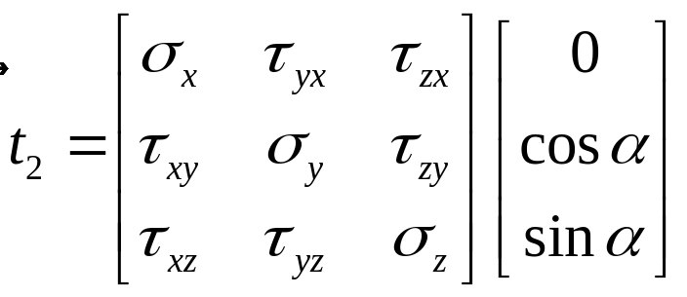
Boundary Conditions on S2
Normal Force - CAUC- 2011

Slide 17
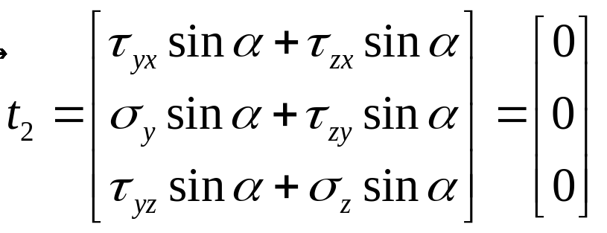

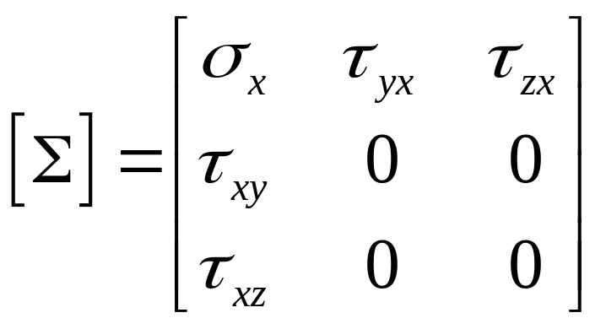
Boundary Conditions on S2
Normal Force - CAUC- 2011

Slide 18
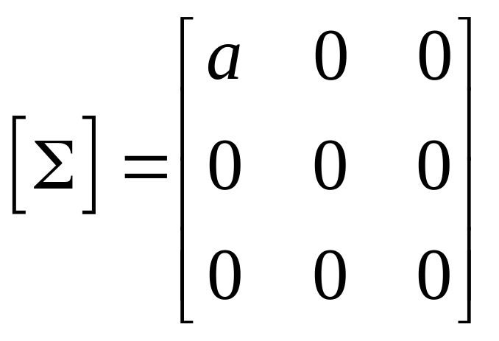
A stress tensor that verify the BC’s
Normal Force - CAUC- 2011

Slide 19
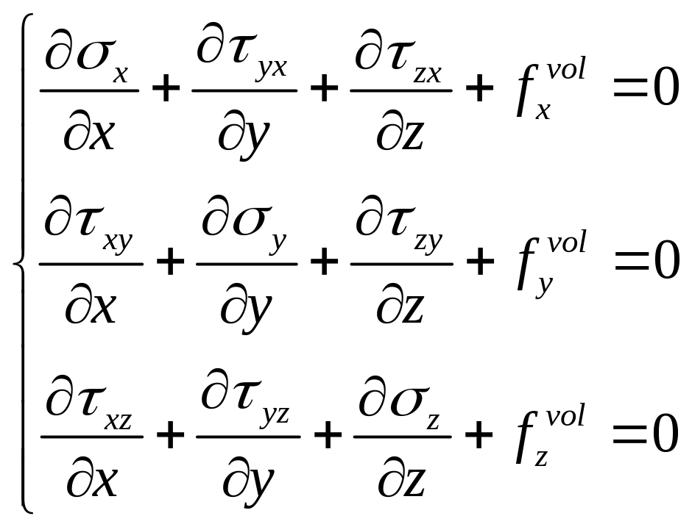
Equilibrium’s Equation
Normal Force - CAUC- 2011

Slide 20
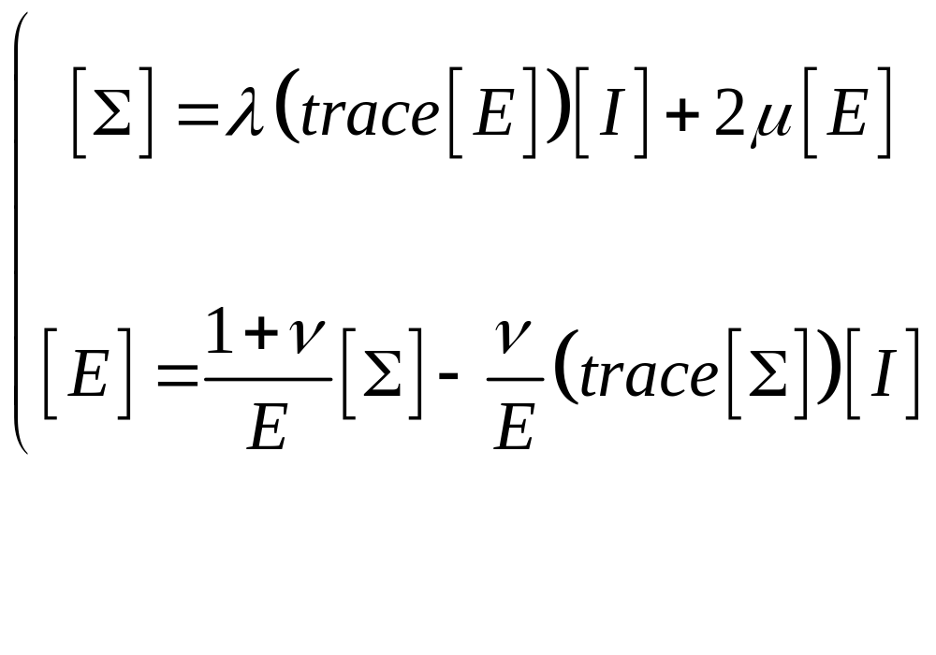
Relationship Stress/ Strain
Normal Force - CAUC- 2011

Slide 21
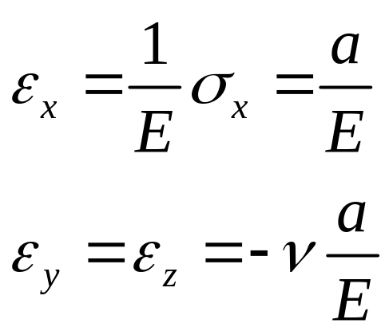
Relationship Stress/ Strain
Normal Force - CAUC- 2011

Slide 22
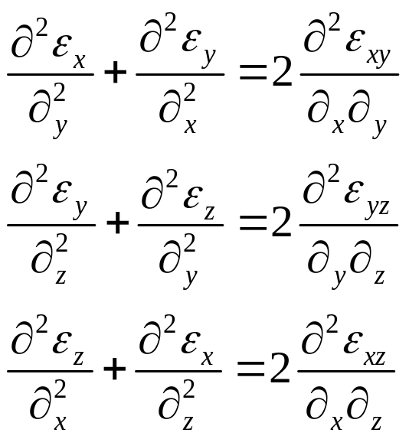
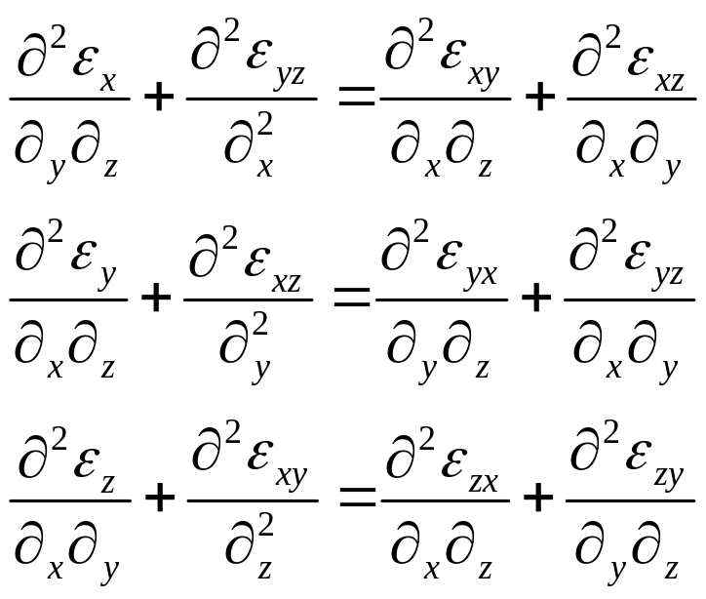
Equation for Compatibility
Normal Force - CAUC- 2011

Slide 23
Solution
The solution that verify the whole conditions is :
Normal Force - CAUC- 2011

Slide 24
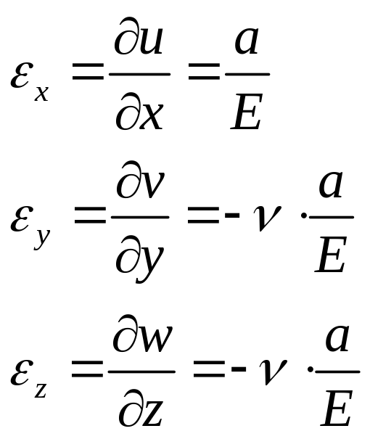
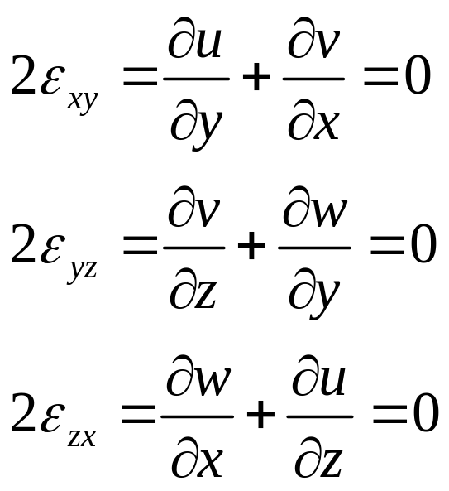
Strains
Normal Force - CAUC- 2011

Slide 25
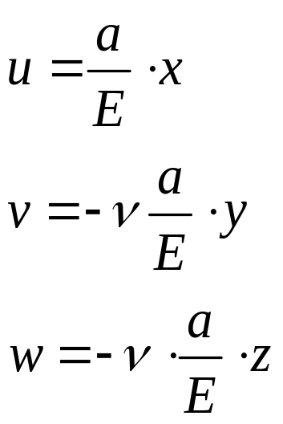
Field of Displacement
The solution is :
The displacement u is the same for all the points of the cross section. The cross section remains flat
The displacements v and w are created by a Poisson’s ratio effect
Normal Force - CAUC- 2011

Slide 26
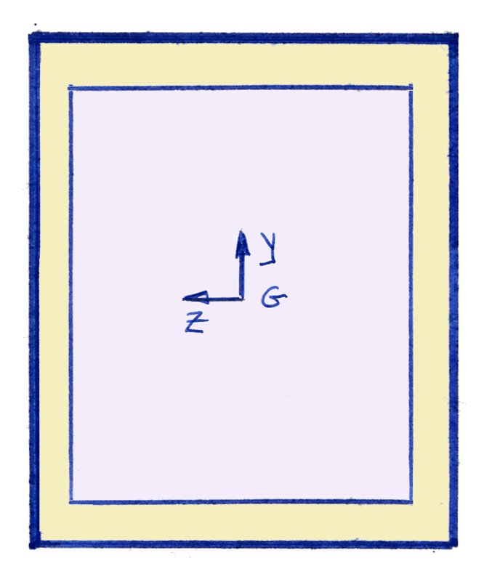
Field of Displacement
The right angles do not change.
The area of the cross section decreases when a tensile stress is applied.
Remark : Iron with
Young’s modulus = 200 GPa,
Poisson’s ration = 0.3
Less than 0.2 % for the surface
Normal Force - CAUC- 2011

Slide 27
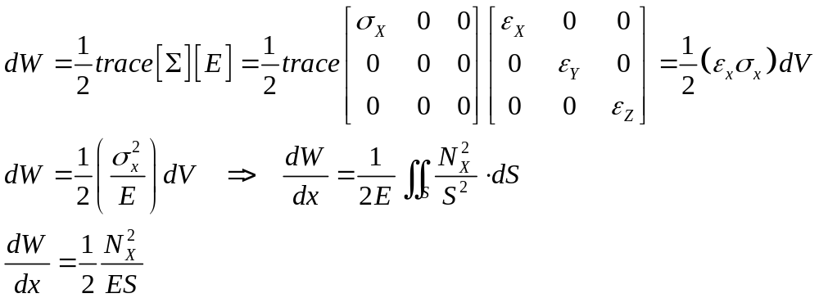
Internal Energy
Normal Force - CAUC- 2011

Slide 28
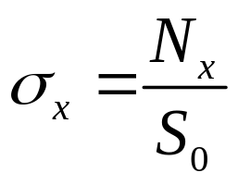
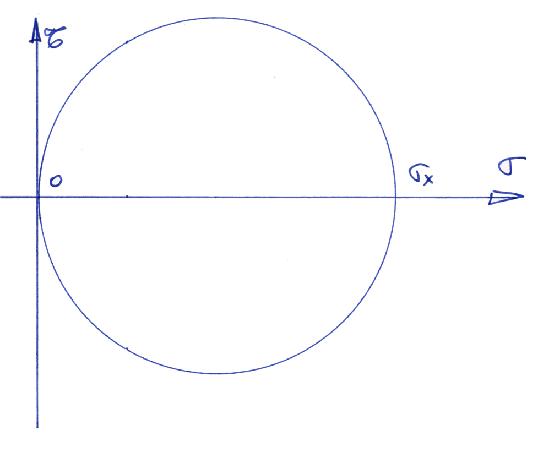
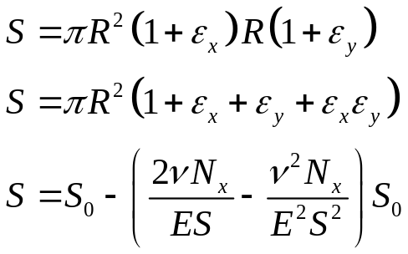
Mohr’s Circle for the stresses
In fact, by the Poisson effect, the surface of the cross section decreases
Normal Force - CAUC- 2011

Slide 29
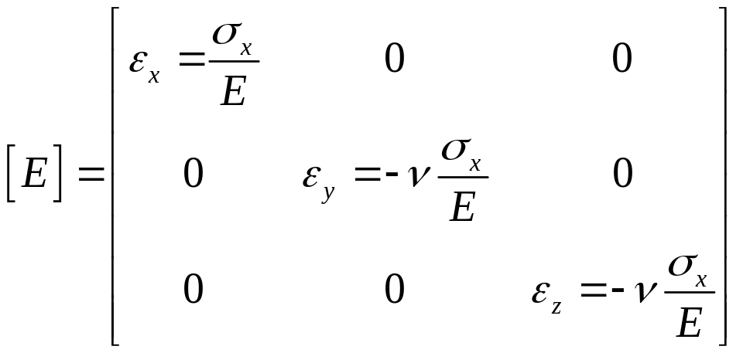
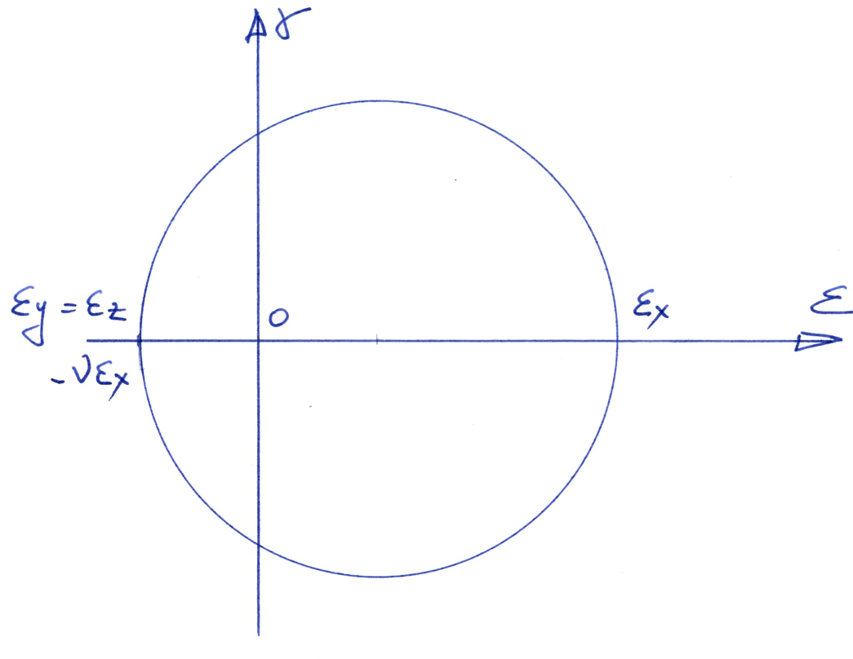
Mohr’s Circle for the strains
Normal Force - CAUC- 2011

Slide 30
Beams with rectilinear middle line
We do the assumption that the cross section still remains flat.
Faire deux d »ssins
Répartition de contrainte
Effort ponctuel
Mêm Nx
Intégrer les équations et trouver que Nx=F/S et le reste nul
Normal Force - CAUC- 2011

Slide 31
Beams with curvature and cross section not constant
We shall do the assumption that the results found in the case of
beams with a constant cross section and a straight middle line
can be applied in the case of beams whose :
The variation of the cross section is weak,
The curvature of the middle line is small (or the radius of curvature is great)
If these two conditions are respected, the experimental
results are accurate with the theoretical result.
Normal Force - CAUC- 2011

Slide 32

Metalic Lattice Structure
A lattice structure is made of a lot of different beams
Normal Force - CAUC- 2011

Slide 33

Metalic Lattice Structure
A beam with 2 ball joins is named a Bar
Equilibrium :
Normal Force - CAUC- 2011

Slide 34

Metalic Lattice Structure
A Bar can only works in traction or compression
Assumption : A lattice structure is made of a lot of different beams. Each one of these beams works like a Bar.
Normal Force - CAUC- 2011

Slide 35





Metalic Lattice Structure
Relation Load Displacement
The strain is
Normal Force - CAUC- 2011

Slide 36

Metalic Lattice Structure
Strains function displacements
The strain is
Normal Force - CAUC- 2011

Slide 37




Metalic Lattice Structure
Strains function displacements
Normal Force - CAUC- 2011

Slide 38


Metalic Lattice Structure
Internal Energy
Important remark : The Internal Energy don't depend of the field of displacement in the direction of the middle line of the bar
Normal Force - CAUC- 2011

Slide 39



Metalic Lattice Structure
Relation Load Displacement
Normal Force - CAUC- 2011

Slide 40

Metalic Lattice Structure : Exemple 1
Number of solid :
Number of equations :
Number of unknown forces :
The system is an isostatic system
Normal Force - CAUC- 2011

Slide 41
Metalic Lattice Structure : Exemple 1
Remark 1 : N_{AB} will always be the normal load in the bar AB.
Remark 2 : N_{AB} =N_{BA}
Remark 3 : All the bars will be considered as working in traction
Normal Force - CAUC- 2011

Slide 42
Metalic Lattice Structure : Exemple 1
Second Step : Equilibrium of the lattice structure
Second Step : Equilibrium of each nodes
Normal Force - CAUC- 2011

Slide 43
Metalic Lattice Structure : Exemple 1
Third Step : resolution in term of normal forces
Fourth Step : resolution in term of displacement
Normal Force - CAUC- 2011

Slide 44

Metalic Lattice Structure : Exemple 2
Number of solid :
Number of equations :
Number of unknown forces :
The system is an hyperstatic system
Normal Force - CAUC- 2011

Slide 45
Metalic Lattice Structure : Exemple 2
First step : Choose an unknown hyperstatic normal force, for
instance N_{DB}
Secon step : Wriite the Castigliano’s theorem
Normal Force - CAUC- 2011

Slide 46


Metalic Lattice Structure : Exemple 3
Normal Force - CAUC- 2011

Slide 47
Metalic Lattice Structure : Exemple 3
Normal Force - CAUC- 2011

